Slide 1
Data Dimensions investigation on sample data
Data Dimension | Definition | Impact
Completeness | What data is missing or unusable? | Missing data will be a hindrance in numerous downstream processes such as reports, consolidation, matching etc
Conformity | What data is stored in non standard format? | Maintaining conformance to specific formats is important in data representation,presentation,aggregate reporting,search, and establishing key relationship
Consistency | What data values gives confilcting information? | Inconsistency between data values plagues organizations attempting to reconcile between different systems and applications
Duplication | What data records or attributes are repeated? | The inability to maintain a single representation for each entity across your systems poses numerous vulnerabilities and risks
Accuracy* | What data is incorrect or out of date? | Impact in operational and analytical applications
Timeliness* | What data is up to date and information available on time? | Leading to ineffective use of the data and a lack of data driven decisions
Integrity* | Is data interpreted or related amongst systems differently? | The inablity to link related records together may actually introduce duplication across your systems
* These parameters requires extensive studies and client involvement

Slide 2
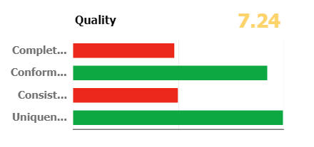
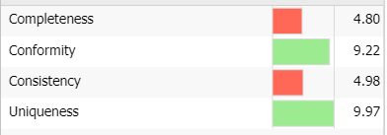
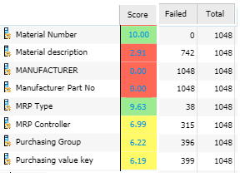
Data Quality Scorecard
0-5 Low
5-8 Medium
8-10 Good

Slide 3
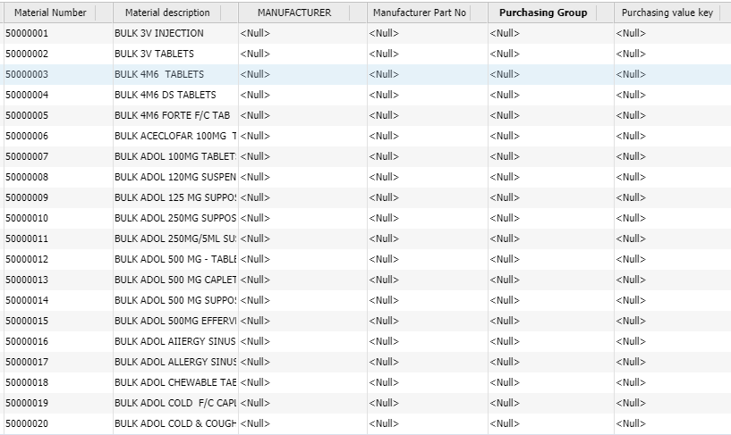
Completeness

Slide 4
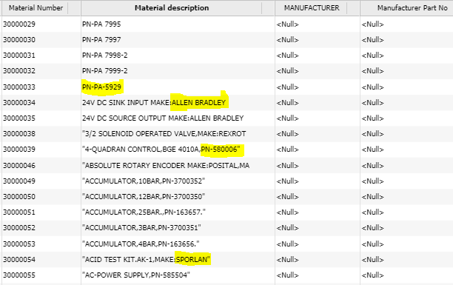
Conformity

Slide 5

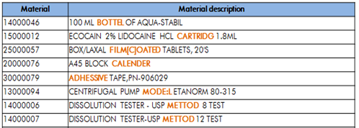
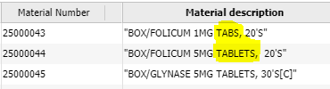


Consistency

Slide 6
Material Description - Potential Duplicates

Slide 7
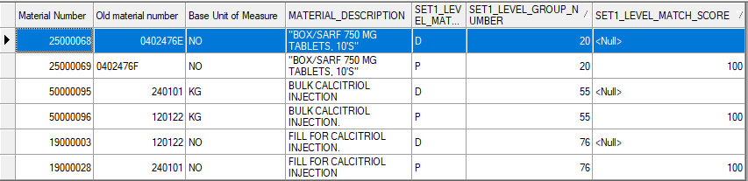
Material Description - Duplicates

Slide 8
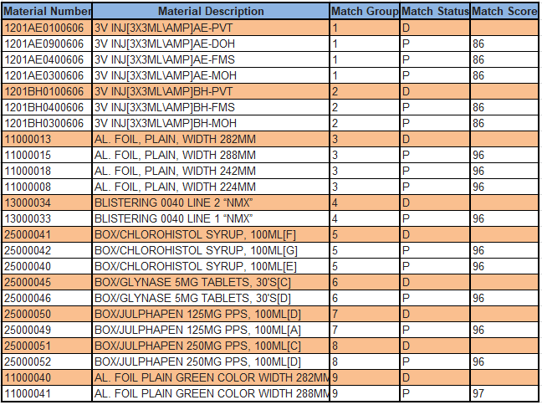
Material Description - Duplicates

Slide 9




















Data cleansing lifecycle
JOURNEY FROM DATA MIGRATION TO DATA GOVERNANCE
Data Sources
Data Staging and Test Environment
Loading
Target System
SAP / MDG
SAP / Non SAP Target Systems
Performance Analysis
Dashboards and Business Reporting
Staging Area
SAP S4
Flat Files/
Excel
Pre-Built load routines for SAP Objects
Data Services Platform
Files / LSMW
Validate & load
SAP IS
Databases
Cleanse
Transform
Name Parsing
Transform
Data into SAP structure
Business Validation Rules
IDocs
SAP
Extract & Profile
Address Parsing & Correction
Automatic SAP Config Validation
Material/Product Parsing
SAP ECC / CRM
Applications
Matching
Reconciliation
SAP
Configuration
Extraction
XML
Transparency, Communication
Other Systems
Sweet spot
Cleansing merged into MDG
Clean your data
SAP DS / IS
Keep it clean
SAP MDG

Slide 10
Strategize Process
A
Finalize organizational requirements
Priorities, KPIs, Targets & DACs
Data Monetizing opportunities
Plans with monitoring & controlling measures
E
Finalize
Define
Strategize
B
D
Validate & Enhance
C
Extract
Data Dimension KPIs / Targets
Data dimensions
priority
KPI Targets
Guidelines
Numerous data dimensions are available
Completeness, Conformity, Consistency, Duplicates, Accuracy, Integrity and accessibility are the key ones to consider
Target setting for each data dimensions
Based on availability of information
Remember, law of diminishing returns
Local purchasing practices, Pharma industry guidelines, QA/ QC requirements, Auditing KPIs (internal & external), Physical verification and others

Slide 11
Extract Process
A
Research available data and extract relevant information
Existing data, manuals & drawings
Web based catalogues
Physical verification
Vendor contact
E
Finalize
Define
Extract
B
D
Validate & Enhance
C
S&V Accelerators
Personnel
Technology
Methodologies
Extraction of relevant data requires data consultants and their discretion
S&V data consultants are engineers
Understanding of taxonomy is critical
Data Dictionaries fed into tools can make it intelligent
Tools provide the ability to standardize and parse data (~30% – 50%)
Potential duplicates identification methodologies
PMBOK for project management
DMBOK for data management
BMBOK for business requirements analysis
Iterative processing

Slide 12
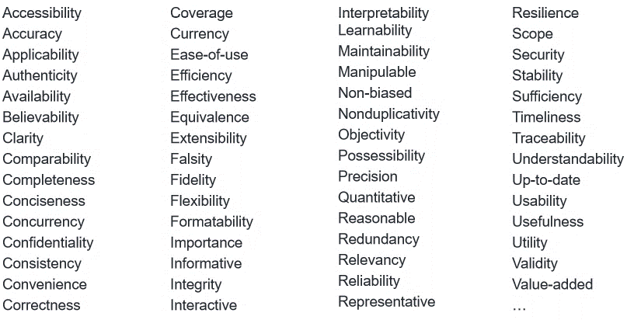
Data Dimensions

Slide 13
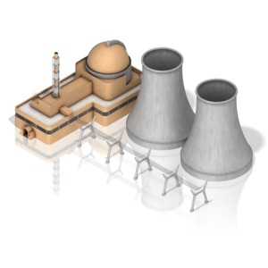
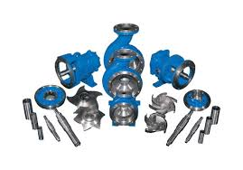
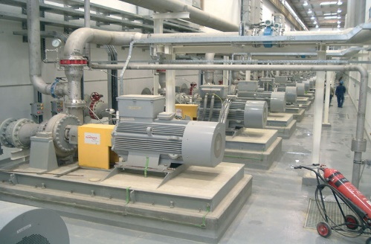
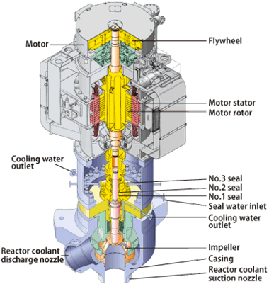
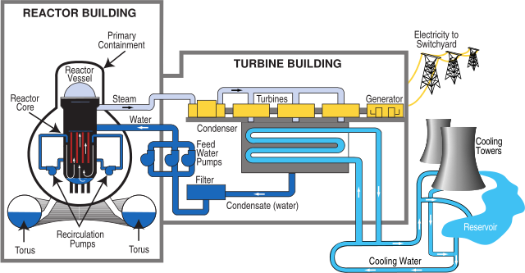
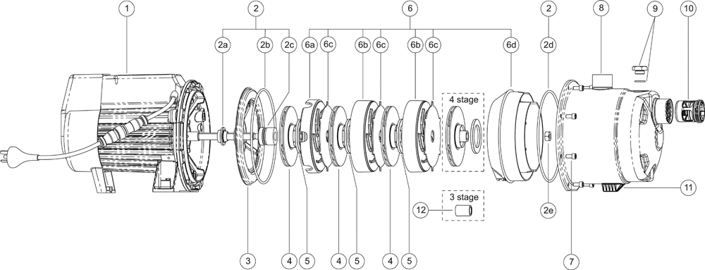
Standards – Unfortunately are different
DATA
DATA
DATA
OEM Manuals
O&M Stage
Mapped to assembly / materials / BOM
Green Field Vs Brown Field
EPC Stage
Mapped to FLOC
OEM Manuals
O&M Stage
Mapped to Equipments (Sub0
Power Plants designation standards (ISO 81346 etc)
Equipment breakdown standards (ISO 14224 etc)
Materials Cataloguing Standards (UNSPSC, 22745, eOTD etc)

Slide 14
S&V research & outcome | Accelerator
STANDARD FORMS | VARIATION | STANDARD FORMS | VARIATION
AMPOULE | AMPOULE | CAPSULE | CAPSULE
AMPOULE | AMP. | CAPSULE | CAP.
AMPOULE | AMP, | CAPSULE | CAPSULES
AMPOULE | AMP | CAPSULE | FAPSULE
AMPOULE | QMPOULE | CAPSULE | VAPSULE
AMPOULE | WMPOULE | CAPSULE | CQPSULE
AMPOULE | ZMPOULE | CAPSULE | CWPSULE
AMPOULE | XMPOULE | CAPSULE | CZPSULE
AMPOULE | ANPOULE | CAPSULE | CXPSULE
AMPOULE | AHPOULE | CAPSULE | CAOSULE
AMPOULE | AJPOULE | CAPSULE | CALSULE
AMPOULE | AKPOULE | CAPSULE | CAPQULE
AMPOULE | ALPOULE | CAPSULE | CAPWULE
TABLET | TAB. | INJECTION | INJECTION
TABLET | TABLETS | INJECTION | INJ
TABLET | TABLET | INJECTION | INJ.
TABLET | TABLT | INJECTION | INJ,
TABLET | TAB | INJECTION | INJECT
TABLET | TAB, | INJECTION | INJECTN
TABLET | TQBLET | INJECTION | UNJECTION
TABLET | TWBLET | INJECTION | JNJECTION
TABLET | TZBLET | INJECTION | KNJECTION
Typo Issue are investigated and dictionaries are generated
Letter skipping
Double letters
Reverse Letters
Skipping spaces
Missing the keys
New Keys inserted

Slide 15
Tool expertise
Match Comparison Option | Example | Value Add
Word Similarity | FOR ADOL SUPPOSITORY and FOR SUPPOSITORY ADOL | Out of sequence words
Transposition checking | A3-30-2500 and A3-46-2500 | Data Entry errors
Abbreviations adjustment | AIRHANDLING UNIT and AHU DS and DOUBLE STRENGTH | Entry shortcuts
Numeric Matching | 20MG 2ML and 2ML 20MG | Enforce Numeric accuracy
Text to Numbers | 1-PROPANOL and ONE-PROPANAL | Data entry variations

Slide 16
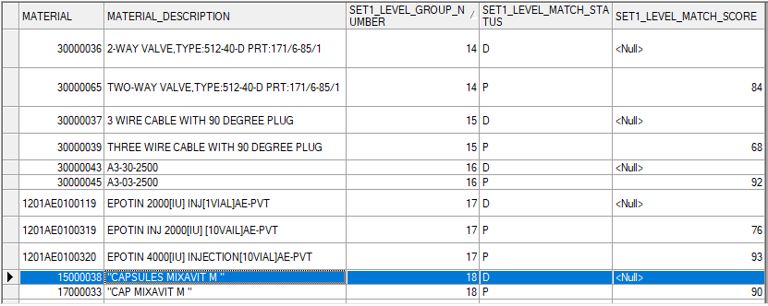
Material Description - Duplicates
Go back

Slide 17
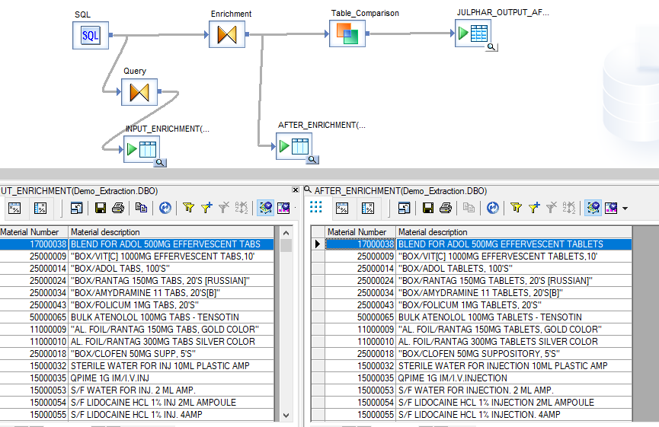
Consistency Data Enrichment

Slide 18
Data Dictionary – What is it?
Source Description
Noun
Modifier
Attribute 1
Attribute 2
Attribute 3
Attribute 4

Slide 19
Data dictionary with Julphar example
Noun
Material Number | Material Description
1201BH0301401 | CLOFEN INJ[50x3ML\AMP]BH-MOH
Cleansed Description
Injection
No Modifier
INJECTION CLOFEN DICLOFENAC SODIUM 50 X 3 ML AMP BH-MOH
Modifier
Product Name
CLOFEN
Chemical Name
DICLOFENAC SODIUM
Size/Dosage
50 X 3 ML AMP
Form of Supply
Go back
Source of Supply
BH-MOH

Slide 20
Final description development
Material No | Material Description | Short Description | Long Description | Attributes | Values
1201BH0301202 | CYNOVIT INJ[50X1ML\AMP]BH-MOH | INJECTION CYNOVIT 50 X 1 ML/AMP BH-MOH | INJECTION;PRODUCT NAME:CYNOVIT,SIZE/DOSAGE:50 X 1 ML/AMP,SOURCE OF SUPPLY:BH-MOH | NOUN | INJECTION
 |  |  |  | MODIFIER
 |  |  |  | PRODUCT NAME | CYNOVIT
 |  |  |  | TYPE
 |  |  |  | CHEMICAL NAME
 |  |  |  | SIZE/DOSAGE | 50 X 1 ML/AMP
 |  |  |  | FORM OF SUPPLY
 |  |  |  | SOURCE OF SUPPLY | BH-MOH
Source Details : https://www.cnc.info.pl/files/bg_e_389.pdf

Slide 21
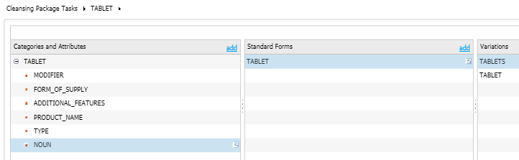
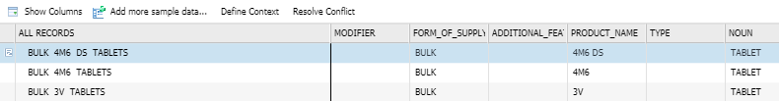
Cleansing Package Creation
Defining Attributes
Defining Standard forms and Variation
Source Description
Parsing data using Standard forms against Attribute

Slide 22
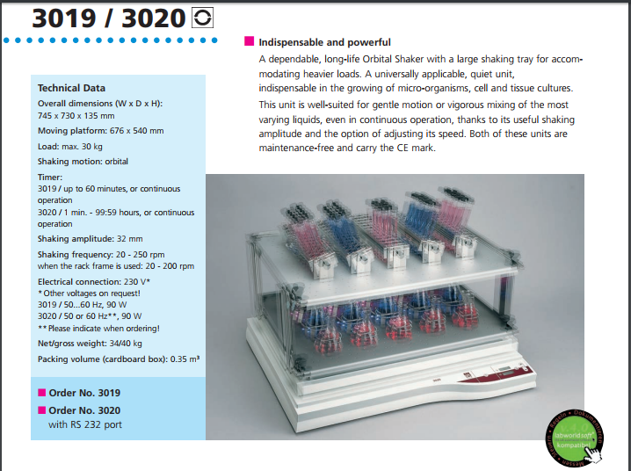
Why human involvement is required?
Step 3: Capture the Technical Information relevant to the Attributes
Findings and Recommendations
Material Number 14000012 carries two different model in its description (GFL SHAKERS 3019/3020) , which can’t be identified by cleansing process.
While performing enrichment activities it has been identified and needs to be assigned to two different Material Number.

Slide 23
Output recommendation (with enrichment)
Material No | Material Description | Status | Short Description | Long Description | Attributes | Cleansed | Enriched | Manufacturer | Manufacturer Part No
14000012 | GFL SHAKERS 3019/3020 | Cleansed | SHAKER | SHAKER | NOUN | SHAKER | SHAKER | GFL | 3019/3020
 |  | Enriched | SHAKER LAB ORBITAL 32 MM 20-250RPM 230V | SHAKER-SHAKER-LABORATORY;TYPE:ORBITAL MOTION,TIMER:UPTO 60 MIN,SHAKING AMPLITUTE:32 MM,SHAKING FREQUENCY:20 TO 250 RPM,ELECTRICAL RATING:230 V, 50 HZ, 90 W,DIMENSION:745 X 730 X 135 MM,PLATFORM SIZE:676 X 540 MM,STANDARDS/SPECIFICATION:CE | MODIFIER | NO MODIFIER | LABORATORY | GFL | 3019
 |  |  |  |  | TYPE |  | ORBITAL MOTION
 |  |  |  |  | TIMER |  | UPTO 60 MIN
 |  |  |  |  | SHAKING AMPLITUTE |  | 32 MM
 |  |  |  |  | SHAKING FREQUENCY |  | 20 TO 250 RPM
 |  |  |  |  | ELECTRICAL RATING |  | 230 V, 50 HZ, 90 W
 |  |  |  |  | DIMENSION |  | 745 X 730 X 135 MM
 |  |  |  |  | PLATFORM SIZE |  | 676 X 540 MM
 |  |  |  |  | ADDITIONAL FEATURES
 |  |  |  |  | STANDARDS/SPECIFICATION |  | CE

Slide 24
Output recommendation (with enrichment)
Material No | Material Description | Status | Short Description | Long Description | Attributes | Cleansed | Enriched | Manufacturer | Manufacturer Part No
14000012 | GFL SHAKERS 3019/3020 | Cleansed | SHAKER | SHAKER | NOUN | SHAKER | SHAKER | GFL | 3019/3020
 |  | Enriched | SHAKER LAB ORBITAL 32 MM 20-250RPM 230V | SHAKER-LABORATORY;TYPE:ORBITAL MOTION:TIMER:1 MIN TO 99.59 HRS:SHAKING AMPLITUTE:32 MM:SHAKING FREQUENCY:20 TO 250 RPM:ELECTRICAL RATING:230 V, 50 HZ, 90 W:DIMENSION:745 X 730 X 135 MM:PLATFORM SIZE:676 X 540 MM:ADDITIONAL FEATURES:WITH RS 232 PORT:STANDARDS/SPECIFICATION:CE | MODIFIER | NO MODIFIER | LABORATORY | GFL | 3020
 |  |  |  |  | TYPE |  | ORBITAL MOTION
 |  |  |  |  | TIMER |  | 1 MIN TO 99.59 HRS
 |  |  |  |  | SHAKING AMPLITUTE |  | 32 MM
 |  |  |  |  | SHAKING FREQUENCY |  | 20 TO 250 RPM
 |  |  |  |  | ELECTRICAL RATING |  | 230 V, 50 HZ, 90 W
 |  |  |  |  | DIMENSION |  | 745 X 730 X 135 MM
 |  |  |  |  | PLATFORM SIZE |  | 676 X 540 MM
 |  |  |  |  | ADDITIONAL FEATURES |  | WITH RS 232 PORT
 |  |  |  |  | STANDARDS/SPECIFICATION |  | CE
Go back

Slide 25
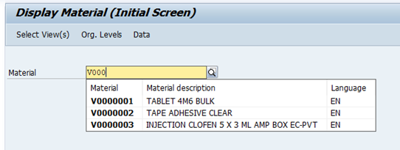
Julphar Data – Loading into SAP using IDoc – Scenario 1
IDoc Status
Go back
Source data migrated into SAP system

